Slide 1

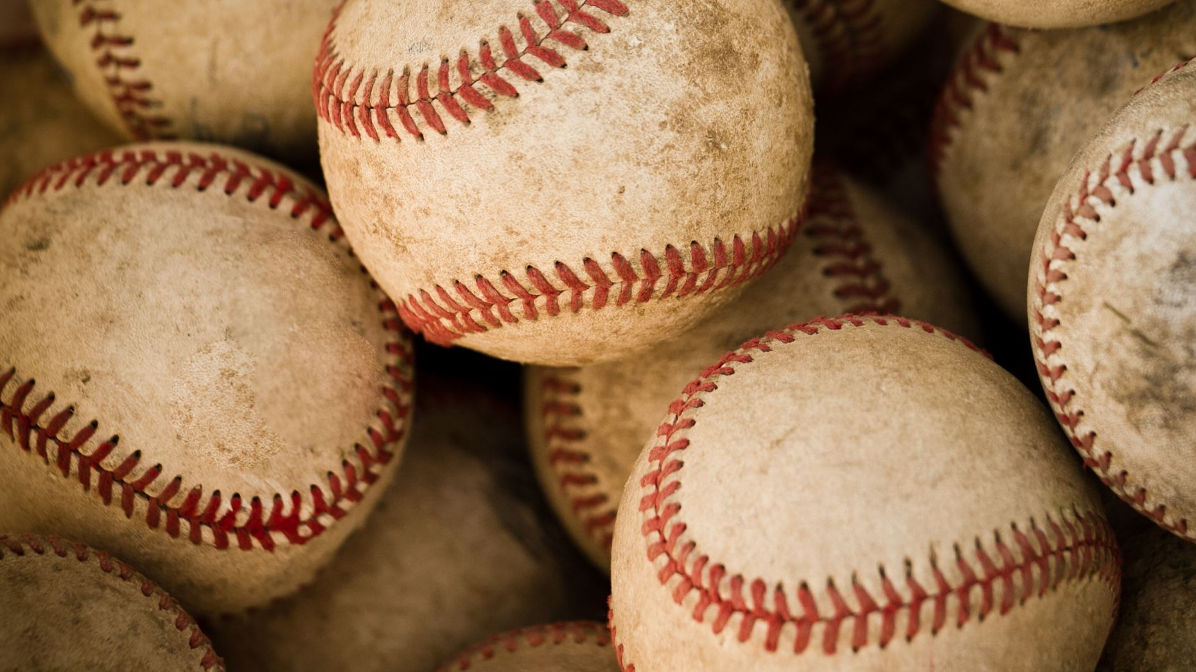
Markov Chain-Based Prediction Algorithm Applied to Baseball
By: Jesse Gailbreath, Jansen Long, Dilafuz Shamsieva, Elijah White, and Ryan Morse

Slide 2

Introduction
Baseball as a sport has a relatively clean and stepwise structure which has made it very open for modeling and analysis of various methods. This is often to the end of predicting outcomes of things ranging from individual plays to entire seasons.
To demonstrate basic parallel processing concepts our team has chosen to recreate an existing implementation of a baseball analysis algorithm with parallelized matrix multiplication.

Slide 3
Goals
Our program intends to leverage Markov-Chain properties to analyze individual baseball player statistics and to produce a stochastic probabilities matrix. This product can be used in multiple ways. We will use this information to analyze individual pitcher-batter match-ups.

Slide 4
Importance of Matrix Multiplication
Matrix multiplication is a fundamental operation in scientific computing. Here are just a few of countless uses of this fundamental linear algebra operation:
compactly notating systems of linear equations
solving least squares problems, e.g. linear regression (both the analytical and the iterative solution)
characteristic equations in differential equations are based on eigenvalue decomposition
dimensionality reduction (PCA)
decompositions such as SVD (since M=UΣV∗), which can be used e.g. in topic modeling (LSA)
developing search result ranking algorithms (e.g. PageRank)
finding the transitive closure in graphs
solving the all-pairs shortest path (APSP) problem
Source: https://marek.ai/matrix-multiplication-on-cpu.html

Slide 5
Why Use Markov Chains for Sports Analysis?
It has advantages in terms of speed and precision.
From successional data, a Markov model is relatively simple to construct.
The primary parameters of dynamic change (in context of the sport's dynamics as it generates massive amounts of data) are summarized in the transition matrix.
It provides a comprehensive view of the sports system’s evolution over time.
It can easily model additional data and new parameters as data collection is improved.
(Pathak, 2021)

Slide 6
Markov-Chain Approach
1
0.5
A Markov-Chain model is constructed from states and the probabilities of transitioning between those states.
Pictured here is a finite state machine with three states. The arrows represent the probability of a particular state transition occurring when at a given state. This can be represented in the form of a matrix.
0.6
0.75
3
0.5
2
0.25
0.4

Slide 7
Markov-Chain Approach
To
From |  | 1 | 2 | 3
 | 1 | 0 | 0.5 | 0.5
 | 2 | 0.6 | 0.4 | 0
 | 3 | 0.75 | 0.25 | 0
This is the matrix representation of the previous figure. Highlighted in yellow is a transition matrix.
Example use: The probability of moving from state 3 to state 1 is 0.75 or 75%.
The usages of the Markov-Chain are far to numerous for us to explain in extensive detail.

Slide 8
Markov-Chain Approach
To
From |  | 1 | 2 | 3
 | 1 | 0 | 0.5 | 0.5
 | 2 | 0.6 | 0.4 | 0
 | 3 | 0.75 | 0.25 | 0
Current State
1 | 0 | 0

Slide 9
Methodology
The Markov-Chain approach is generally applied to baseball by breaking a half-inning of play up into 24 different states and attempts to predict the probability of the corresponding state transitions. (Bukiet, 1997)
While this method is tried and true, our team happened across another use of this method that we found interesting and decided it could benefit from parallelization. In this method we will use a 19x19 Absorbing Markov-Chain to generate stochastic transition matrices for individual players. These probabilities will be calculated based on the Count (Balls-Strikes), and the outcomes of At Bats. (Turner, 2020)

Slide 10
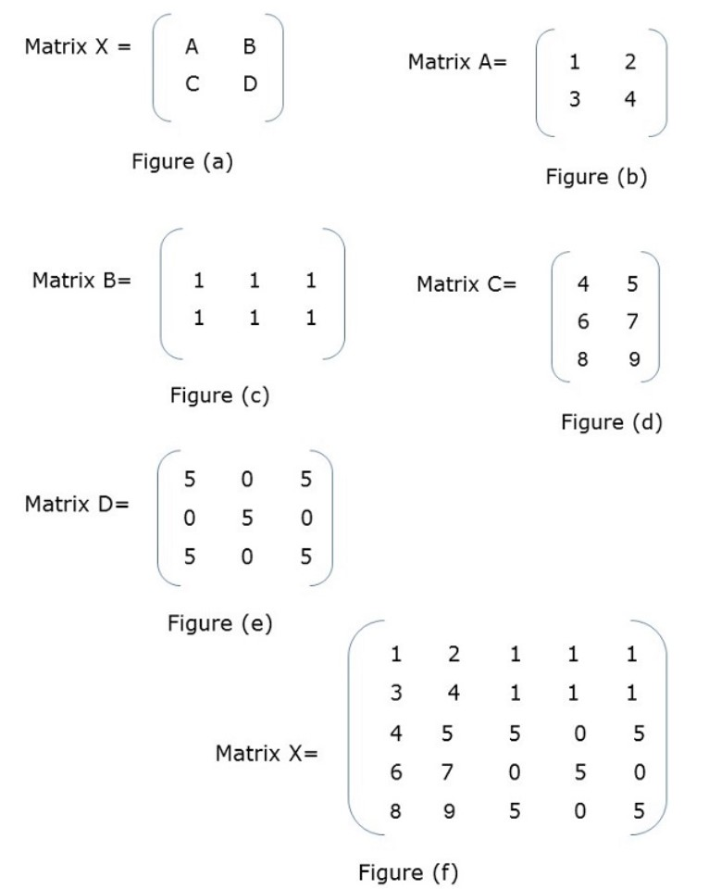
Block Matrix Block Matrix or partitioned matrix is a matrix where each element itself represents an individual matrix. These individual sections are known as a block or sub-matrix. Source: https://www.tutorialspoint.com/parallel_algorithm/matrix_multiplication.htm
In Figure (a), X is a block matrix where A, B, C, D are matrix themselves. Figure (f) shows the total matrix.

Slide 11
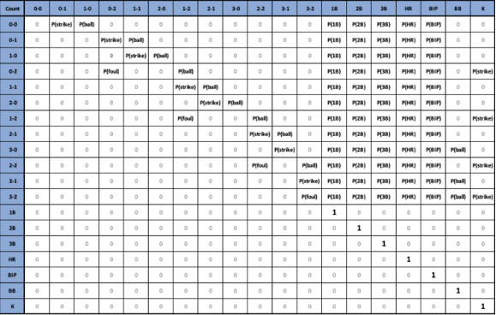
Turner, C. (2020, July 20). "The pinch-hitter problem" The Diamond. Retrieved September 9, 2022,
from https://readthediamond.com/research/thepinch-hitter-problem

Slide 12
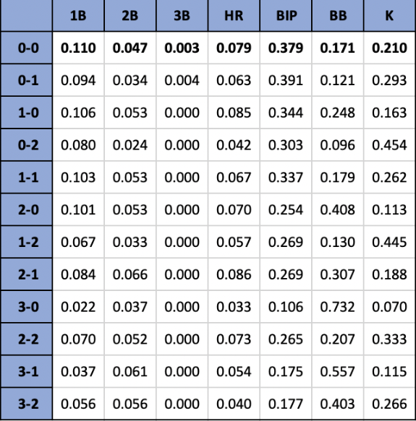
Final Product
This matrix was produced to represent the probabilities of various outcomes of an At-Bat for the 2019 American League MVP Mike Trout.
This is produced by multiplying the original 19x19 transition matrix by itself a sufficient number of times to produce the steady state pictured here.
Turner, C. (2020, July 20). "The pinch-hitter problem" The Diamond. Retrieved September 9, 2022,
from https://readthediamond.com/research/thepinch-hitter-problem

Slide 13

What type of data are we processing? Our team pulled the data from the MLB Statcast system. baseballsavant.mlb.com
balls | 3
strikes | 2
Row Labels | Count of description | Count of events
ball | 114 | 114
walk | 114 | 114
blocked_ball | 7 | 7
walk | 7 | 7
called_strike | 27 | 27
strikeout | 27 | 27
foul | 215
(blank) | 215
foul_tip | 8 | 8
strikeout | 8 | 8
hit_by_pitch | 2 | 2
hit_by_pitch | 2 | 2
hit_into_play | 197 | 197
double | 19 | 19
field_error | 2 | 2
field_out | 121 | 121
fielders_choice | 1 | 1
grounded_into_double_play | 2 | 2
home_run | 18 | 18
sac_fly | 2 | 2
single | 31 | 31
triple | 1 | 1
missed_bunt | 1 | 1
strikeout | 1 | 1
swinging_strike | 60 | 60
strikeout | 60 | 60
swinging_strike_blocked | 4 | 4
strikeout | 4 | 4
Grand Total | 635 | 420
Rk. |  | Player | Pitches | Total | Pitch % | BIP | 1B | 2B | 3B | HR | SO | BB | BABIP
1 |  | Bumgarner, Madison | 2715 | 2715 | 100 | 528 | 101 | 50 | 3 | 25 | 112 | 49 | .307 | Graphs
savant

Slide 14
Transition matrix: pitcher, Madison Bumgarner regular seasons 2017 through Sept. 2022 .
M. B. COUNT | 0-0 | 0-1 | 1-0 | 0-2 | 1-1 | 2-0 | 1-2 | 2-1 | 3-0 | 2-2 | 3-1 | 3-2 | 1B | 2B | 3B | HR | BIP | BB | K
0-0 | 0 | 0.580497382198953 | 0.37467277486911 | 0 | 0 | 0 | 0 | 0 | 0 | 0 | 0 | 0 | 0.025196335078534 | 0.0104712041884817 | 0 | 0.00916230366492147 | 0.0285 | 0 | 0
0-1 | 0 | 0 | 0 | 0.492575855390575 | 0.436410587475791 | 0 | 0 | 0 | 0 | 0 | 0 | 0 | 0.0458360232408005 | 0.0161394448030988 | 0.0012911555842479 | 0.00774693350548741 | 0.311 | 0 | 0
1-0 | 0 | 0 | 0 | 0 | 0.581 | 0.355 | 0 | 0 | 0 | 0 | 0 | 0 | 0.038 | 0.013 | 0.004 | 0.009 | 0.285 | 0 | 0
0-2 | 0 | 0 | 0 | 0.223325062034739 | 0 | 0 | 0.51985111662531 | 0 |  | 0 | 0 | 0 | 0.0508684863523573 | 0.0148883374689826 | 0 | 0.0086848635235732 | 0.286 | 0 | 0.182382133995037
1-1 | 0 | 0 | 0 | 0 | 0 | 0 | 0.534272300469484 | 0.386854460093897 |  | 0 | 0 | 0 | 0.047887323943662 | 0.0187793427230047 | 0 | 0.0122065727699531 | 0.284 | 0 | 0
2-0 | 0 | 0 | 0 | 0 | 0 | 0 | 0 | 0.34453781512605 | 0.515966386554622 | 0 | 0 | 0 | 0.0823529411764706 | 0.0319327731092437 | 0.00672268907563025 | 0.0184873949579832 | 0.328 | 0 | 0
1-2 | 0 | 0 | 0 | 0 | 0 | 0 | 0.258845437616387 | 0 |  | 0.468342644320298 | 0 | 0 | 0.0418994413407821 | 0.0148975791433892 | 0 | 0.00465549348230913 | 0.258 | 0 | 0.211359404096834
2-1 | 0 | 0 | 0 | 0 | 0 | 0 | 0 | 0 |  | 0.417391304347826 | 0.431884057971014 | 0 | 0.0753623188405797 | 0.0463768115942029 | 0.00289855072463768 | 0.0260869565217391 | 0.297 | 0 | 0
3-0 | 0 | 0 | 0 | 0 | 0 | 0 | 0 | 0 |  | 0 | 0.685393258426966 | 0 | 0 | 0 | 0 | 0.0112359550561798 | 0 | 0.303370786516854 | 0
2-2 | 0 | 0 | 0 | 0 | 0 | 0 | 0 | 0 |  | 0.306526806526807 | 0 | 0.357808857808858 | 0.0571095571095571 | 0.0221445221445221 | 0.00466200466200466 | 0.0128205128205128 | 0.267 | 0 | 0.238927738927739
3-1 | 0 | 0 | 0 | 0 | 0 | 0 | 0 | 0 |  | 0 | 0 | 0.246913580246914 | 0.0740740740740741 | 0.0617283950617284 | 0.0123456790123457 | 0.037037037037037 | 0.24 | 0.567901234567901 | 0
3-2 | 0 | 0 | 0 | 0 | 0 | 0 | 0 | 0 |  | 0 | 0 | 0.425742574257426 | 0.0613861386138614 | 0.0376237623762376 | 0.00198019801980198 | 0.0356435643564356 | 0.285 | 0.23960396039604 | 0.198019801980198
1B | 0 | 0 | 0 | 0 | 0 | 0 | 0 | 0 |  | 0 | 0 | 0 | 1 | 0 | 0 | 0 | 0 | 0 | 0
2B | 0 | 0 | 0 | 0 | 0 | 0 | 0 | 0 |  | 0 | 0 | 0 | 0 | 1 | 0 | 0 | 0 | 0 | 0
3B | 0 | 0 | 0 | 0 | 0 | 0 | 0 | 0 |  | 0 | 0 | 0 | 0 | 0 | 1 | 0 | 0 | 0 | 0
HR | 0 | 0 | 0 | 0 | 0 | 0 | 0 | 0 |  | 0 | 0 | 0 | 0 | 0 | 0 | 1 | 0 | 0 | 0
BIP | 0 | 0 | 0 | 0 | 0 | 0 | 0 | 0 |  | 0 | 0 | 0 | 0 | 0 | 0 | 0 | 1 | 0 | 0
BB | 0 | 0 | 0 | 0 | 0 | 0 | 0 | 0 |  | 0 | 0 | 0 | 0 | 0 | 0 | 0 | 0 | 1 | 0
K | 0 | 0 | 0 | 0 | 0 | 0 | 0 | 0 |  | 0 | 0 | 0 | 0 | 0 | 0 | 0 | 0 | 0 | 1

Slide 15
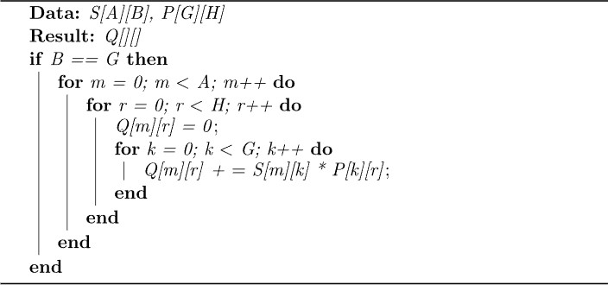
Pseudocode of the Naïve Matrix Multiplication Algorithm

Slide 16
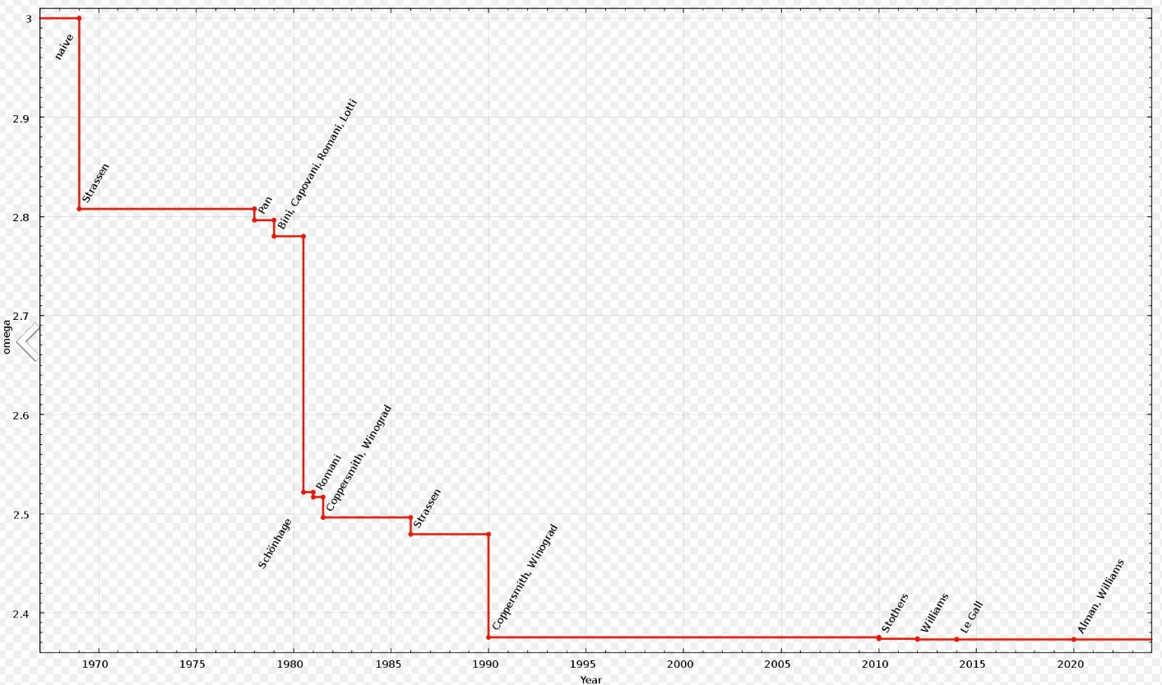
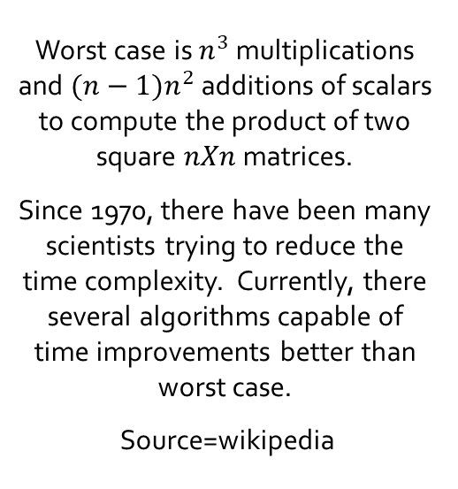
Time Complexity for Matrix Multiplication
Worst case is $n^{3}$ multiplications and $(n−1)n^{2}$additions of scalars to compute the product of two square $nXn$ matrices.
Since 1970, there have been many scientists trying to reduce the time complexity. Currently, there several algorithms capable of time improvements better than worst case.
Source=wikipedia

Slide 17
Models for Parallel Processing
Shared Memory
Threads
Distributed Memory/Message Passing
Hybrid
SPMD (single program multiple data)
MPMD (multiple program multiple data)

Slide 18
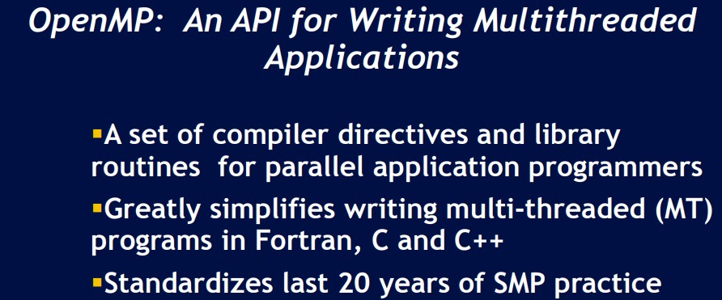
OpenMP uses multi-threading and the shared memory model.
Example program instance:
--One process and many threads.
--Threads read/write to shared memory space.
--OS determines when threads are run (interleaving).
--Synchronization used to make sure correct results are produced.

Slide 19
MPI = Message Passing Interface
• A message-passing library specification
♦ extended message-passing model
♦ not a language or compiler specification
♦ not a specific implementation or product
• Designed to provide access to advanced parallel hardware for end users, library writers, and tool developers.
• Utilizes separate processes with individual stack and heap.
• Point-to-point communication through processes, not pointers.
MPI primarily addresses the message-passing parallel programming model: data is moved from the address space of one process to that of another process through cooperative operations on each process.

Slide 20
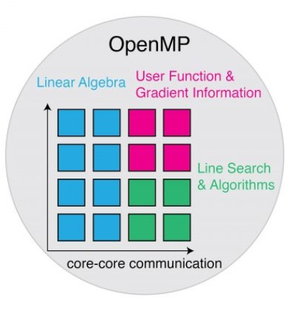
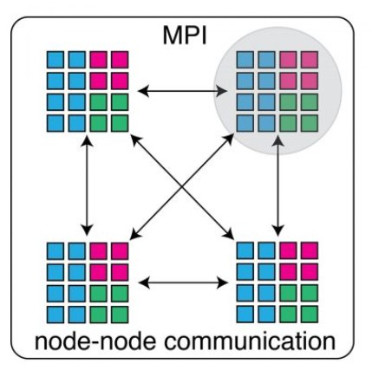
Implementation
OpenMP
MPI
Source: https://www.innovationnewsnetwork.com/using-software-technologies-to-enable-spacecraft-trajectory-optimisation/9615/

Slide 21
Previous Research
Beaudoin, David. "Various applications to a more realistic baseball simulator" Journal of Quantitative Analysis in Sports, vol. 9, no. 3, 2013, pp. 271-283. https://doi.org/10.1515/jqas-2012-0034
Statshacker. (2018, August 14). Statistical analysis of the stochastic Markov matrices. statshacker. Retrieved September 8, 2022, from http://statshacker.com/blog/2018/06/26/statistical-analysis-of-the-stochastic-markov-matrices/
Statshacker. (2018, August 16). An event-based framework for the Markov chain model of baseball. statshacker. Retrieved September 8, 2022, from http://statshacker.com/blog/2018/05/13/an-event-based-framework-for-the-markov-chain-model-of-baseball/
Bukiet, Bruce, et al. “A Markov Chain Approach to Baseball.” Operations Research, vol. 45, no. 1, 1997, pp. 14–23. JSTOR, http://www.jstor.org/stable/171922

Slide 22
Previous Research
Pathak, S. (2021, July 9). Markov chain algorithm in sports. Medium. Retrieved September 8, 2022, from https://medium.com/analytics-vidhya/markov-chain-algorithm-in-sports-a54d086c155e
Turner, C. (2020, July 20). "The pinch-hitter problem" The Diamond. Retrieved September 9, 2022, from https://readthediamond.com/research/thepinch-hitter-problem

